Slide 1
Open RAN
Dian Hanifudin Subhi

Slide 2
Outline
Weekly report
Summary of this week’s work
Your work
Conclusion
Your opinion/thought
Action item

Slide 3
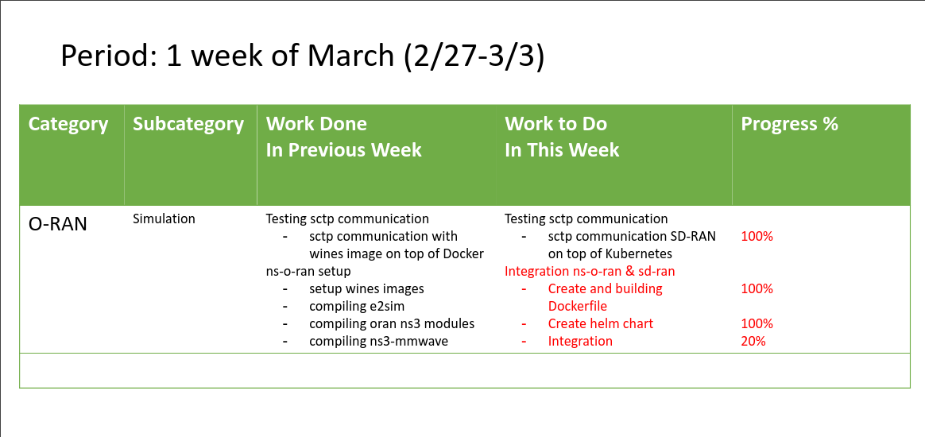
Weekly report

Slide 4
Summary of work this week
Integrate ns-3 with SD-RAN

Slide 5
Question to be Answered
How is the progress of ns3 integration with SD-RAN?

Slide 6
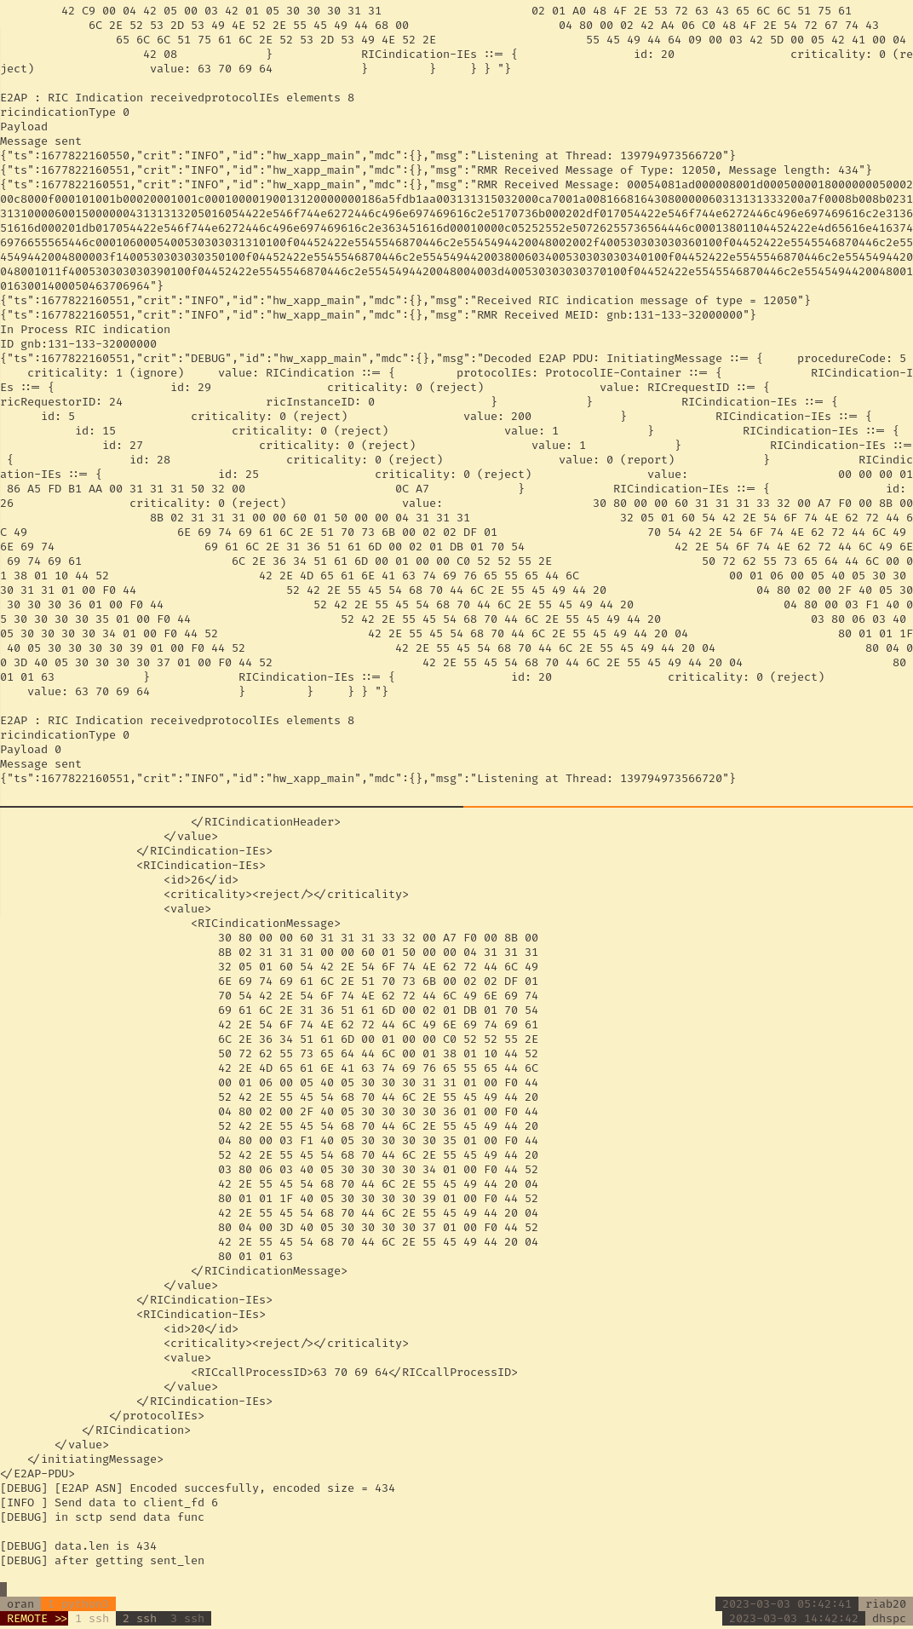
Simulation ns-o-ran
Result for success simulation
Top: output log from sample xapp
Bottom: output ns-3 simulator
Simulation sometime doesn’t works.
References:
https://openrangym.com/tutorials/ns-o-ran

Slide 7
Testing sctp communication
sctp communication SD-RAN
Environments:
Kubernetes
SD-RAN v1.4
sctp-client
Steps
Create Dockerfile
Create helm chart
Get onos-e2t sctp service endpoint

Slide 8
Testing sctp communication
Different between OSC and SD-RAN setup
OSC:
Docker
E2T using 36422
scenario config access directly into docker ip container
ns3 compiled from host
SD-RAN
Kubernetes
onos-e2t using 36421
ns3 oran module doesn’t support dns lookup for kubernetes pod
ns3 needs to deployed into Kubernetes

Slide 9
Testing sctp communication
sctp communication SD-RAN
Environments:
Kubernetes
SD-RAN v1.4
sctp-client
Steps
Create Dockerfile
Create helm chart
Get onos-e2t sctp service endpoint

Slide 10
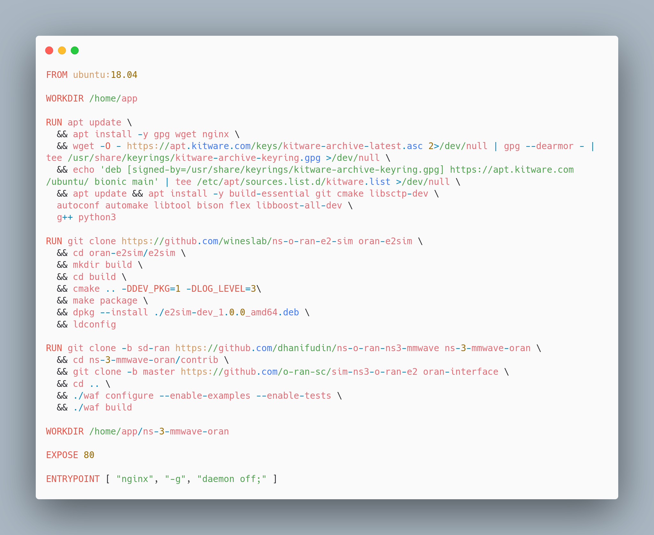
Packaging ns-sd-ran
Create Dockerfile

Slide 11
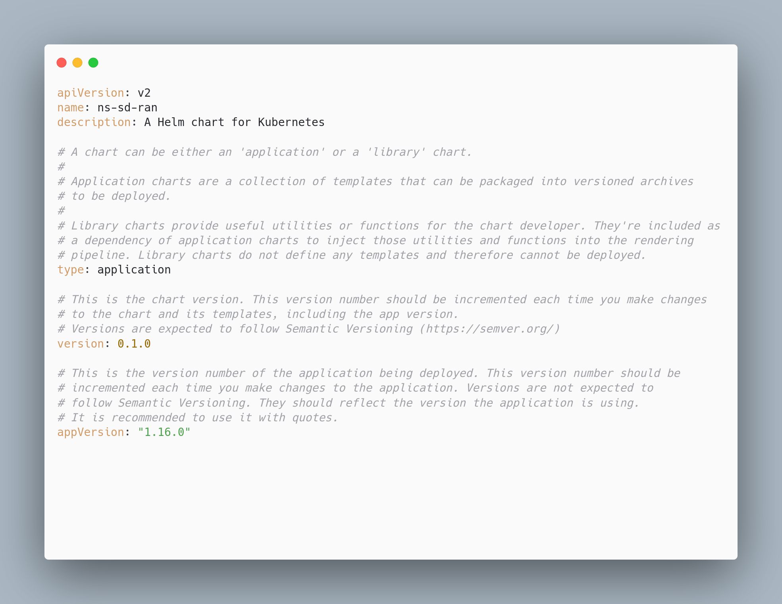
Packaging ns-sd-ran
Create helm chart
Create helm chart
Define image and service

Slide 12
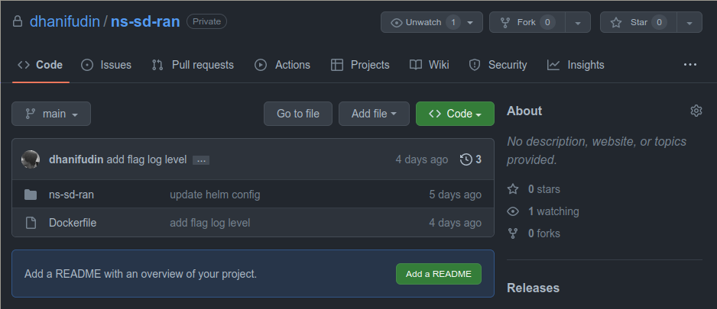
Packaging ns-sd-ran
GitHub Repository
All configuration and modifications can be accessed in https://github.com/dhanifudin/ns-sd-ran

Slide 13
Modify Scenario
Editing endpoint service
ns3-mmwave doesn’t support dns lookup, so we need to change onos-e2t into IP address.
Attach cli into ns-sd-ran pod, then modify the scenario
kubectl -n riab exec --stdin --tty ns-sd-ran-pod -- /bin/bash
vim scratch/scenario-zero.cc and replace with the onos-e2t service IP address.
Run simulation using ./waf --run scratch/scenario-zero.cc

Slide 14
Result
Running simulation
There are error displayed in onos-e2t logs related with decoding error.
Align Bit is not zero
The error related with Go APER library (ASN1) used by onos-e2t project.
Documentation related with error
https://github.com/onosproject/onos-lib-go/blob/master/pkg/asn1/aper/error_list.md

Slide 15
Conclusion
Unstable simulation using ns-o-ran with OpenRAN Gym stack.
There are decoding issue when integrated ns3 with SD-RAN

Slide 16
Your opinion/thought
Unstable simulation with ns-o-ran may be related to different libraries and enabled module versions.
SD-RAN using OAI to have role as CU/DU. Maybe we can take references from the projects to tackle decoding issue.

Slide 17
Action items
Testing ns-o-ran with different version of libraries
Find information about communication between OAI and SD-RAN
Study about encoding-decoding communication on O-RAN

